Slide 1
Machine Learning
Liz Lorenzi and Isaac Lavine

Slide 2
Regression Modeling
Model a continuous response variable Y with covariates X
We will cover:
Linear Models
Regularized Models (Lasso, Ridge regression)
Tree-based methods
Logistic Regression

Slide 3
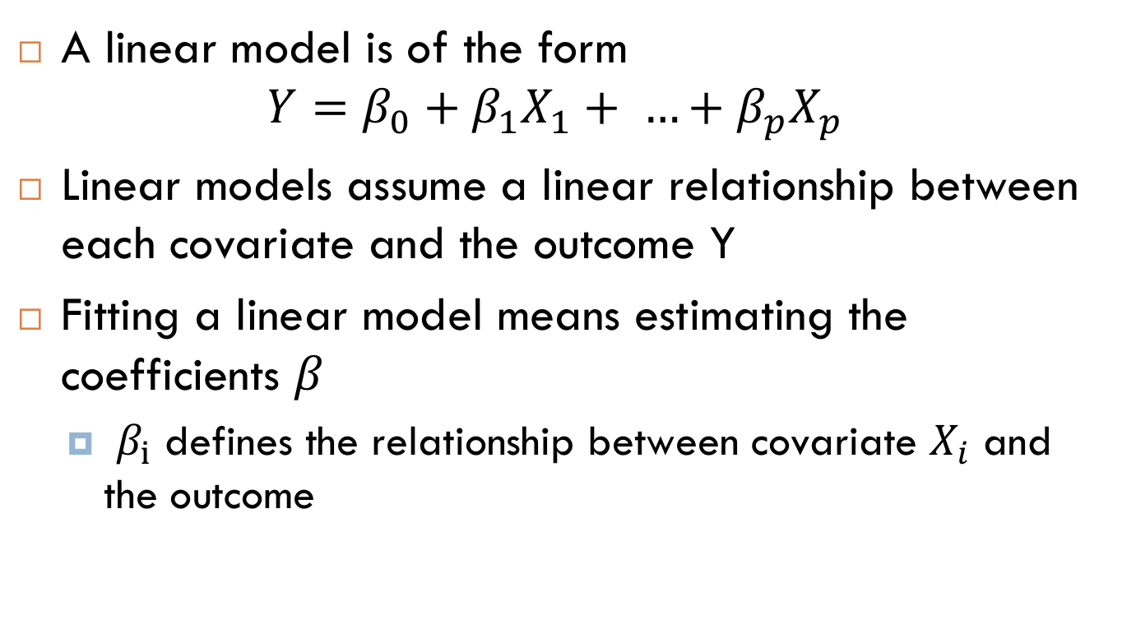
Linear Models
A linear model is of the form
$$Y=β_{0}+β_{1}X_{1}+ …+β_{p}X_{p}$$
Linear models assume a linear relationship between each covariate and the outcome Y
Fitting a linear model means estimating the coefficients $β$
$β_{i}$ defines the relationship between covariate $X_{i}$ and the outcome

Slide 4

Linear Models
Linear model framework can be used to create highly flexible models:
Transform covariates: $X^{2},\log\left(X\right)$
Interactions between covariates: $X_{1}∗X_{2}$
Notes:
Example of a variable with a squared relationship to an object: Physics, if you fire a cannonball, then it will travel in a parabola, so the height will relate to x^2
Example of an interaction term that you might want to include in your model:

Slide 5
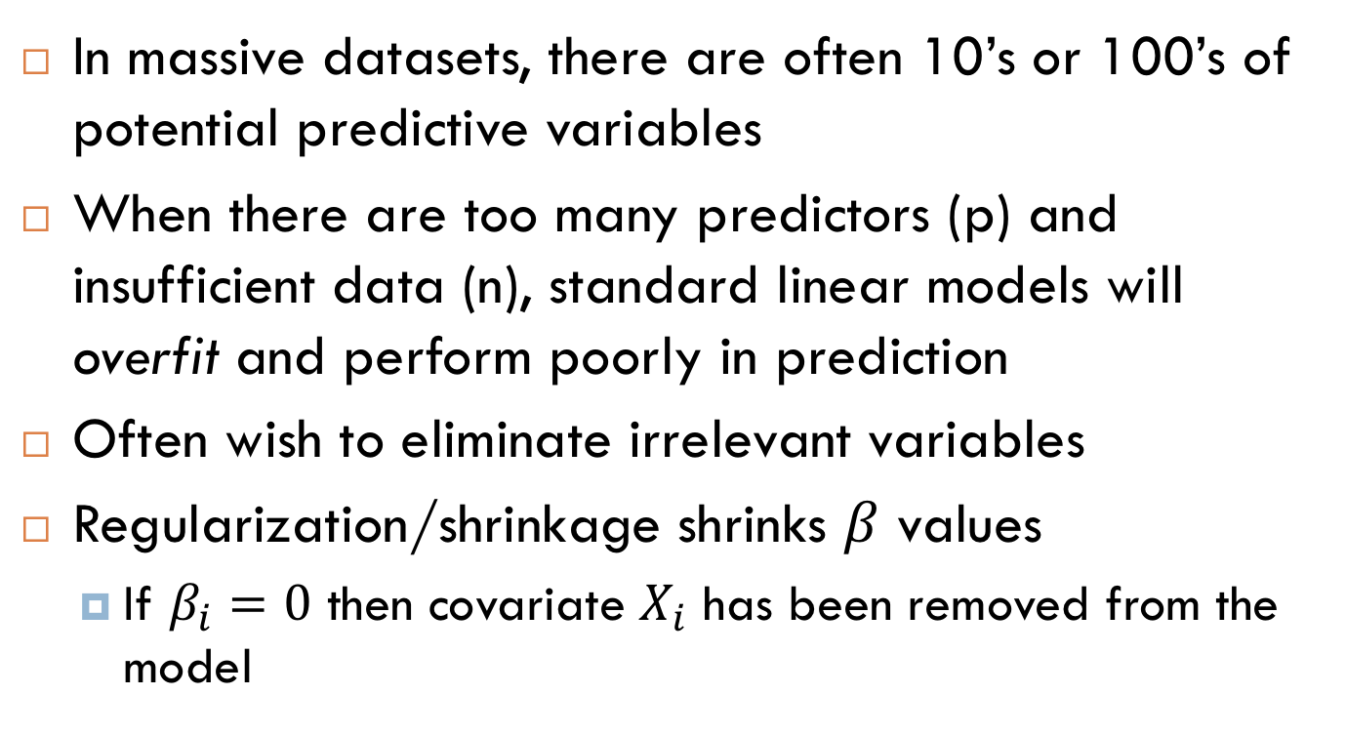
Regularized Linear Models
In massive datasets, there are often 10’s or 100’s of potential predictive variables
When there are too many predictors (p) and insufficient data (n), standard linear models will overfit and perform poorly in prediction
Often wish to eliminate irrelevant variables
Regularization/shrinkage shrinks $β$ values
If $β_{i}=0$ then covariate $X_{i}$ has been removed from the model

Slide 6
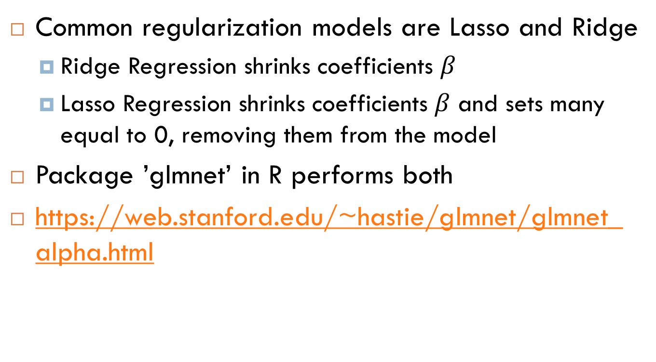
Regularized Linear Models
Common regularization models are Lasso and Ridge
Ridge Regression shrinks coefficients $β$
Lasso Regression shrinks coefficients $β$ and sets many equal to 0, removing them from the model
Package ’glmnet’ in R performs both
https://web.stanford.edu/~hastie/glmnet/glmnet_alpha.html

Slide 7
Model Evaluation
Fitted vs predictive model accuracy
Split data into ‘training’ and ‘test’ sets
Cross Validation
Technique to avoid overfitting to a dataset
Hold out some data, test model accuracy against held out ‘validation’ data
E.g. Hold out 1/10 of data 10 times, get complete ‘out of sample/predictive’ error rate

Slide 8
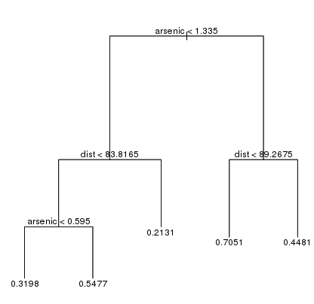
Tree-based Methods
Model outcome Y by a series of ‘splits’ or decisions on covariates
More flexible, non-parametric models
No interpretable covariate effect
Performs well with large datasets

Slide 9
Random Forests
A random forest is created from a succession of decision trees
Each tree is fit to a random sample of the training data
Predictions are made by averaging across different trees
Can provide a measure of variable ‘importance’, but still no interpretable effect

Slide 10
Classification – Logistic Regression and GLMs
Different than previous regression techniques, where the goal was to predict a continuous outcome (like income or home value)
Logistic Regression: Model for a binary outcome
E.g. Life/Death after surgery, Win/Lose in sports, buy/don’t buy in advertising, etc…
Poisson Regression: Model for an integer outcome
E.g. number of arrests in a district
Often can be approximated using standard regression techniques for continuous variables

